Slide 1
What is the DofE?
Notes:
This can be tailored to your specific audience if required.

Slide 2
The DofE is…
Your DofE programme is a real adventure.
It doesn’t matter who you are or where you’re from.
You just need to be aged between 14 and 24.
You can do DofE programmes at three levels:
Bronze (aged 14+)
Silver (aged 15+)
Gold (aged 16+)
…which lead to a Duke of Edinburgh's Award.

Slide 3
The DofE is…
You achieve an Award by completing a personal programme
of activities in four sections:
Volunteering: undertaking service to individuals or the community.
Physical: improving in an area of sport, dance or fitness activities.
Skills: developing practical and social skills and personal interests.
Expedition: planning, training for and completion of an adventurous journey in the UK or abroad.
At Gold level, you must do an additional Residential section, which involves working and staying away from home doing a shared activity.

Slide 4
Time and age requirements
 | Minimum period of participation by:
Level: | Direct entrants | Previous level Award holders
Bronze | 6 months | n/a
Silver | 12 months | 6 months
Gold | 18 months | 12 months
Direct entrants are young people starting their DofE programme at either Silver or Gold level, who have not achieved the previous level of Award.

Slide 5
Bronze Award (14+ years old)
Volunteering | Physical | Skills | Expedition
3 months | 3 months | 3 months | Plan, train for and complete a 2 day, 1 night expedition
All participants must undertake a further 3 months in the Volunteering, Physical or Skills section.

Slide 6
Silver Award (15+ years old)
Volunteering | Physical | Skills | Expedition
6 months | One section for 6 months and the other section for 3 months |  | Plan, train for and complete a 3 day, 2 night expedition
Direct entrants must undertake a further 6 months in the Volunteering or the longer of the Physical or Skills sections.

Slide 7
Gold Award (16+ years old)
Volunteering | Physical | Skills | Expedition | Residential
12 months | One section for 12 months and the other section for 6 months |  | Plan, train for and complete a 4 day, 3 night expedition | Undertake a shared activity in a residential setting away from home for 5 days and 4 nights
Direct entrants must undertake a further 6 months in either the Volunteering or the longer of the Physical or Skills section.

Slide 8
Choosing activities
There is a massive choice of activities that count towards DofE programmes. You can select practically any activity you want – as long as it’s legal and morally acceptable.
Activities are placed in specific sections for a reason.
You need to choose activities you are going to enjoy.
Activities could be something that you are already doing or perhaps one you’ve always wanted to try.

Slide 9
Choosing activities
Think about what you want to do for each
section, and check with your DofE Leader
that your choices can be counted.
Use the helpful lists and category finder on
www.DofE.org/sections.

Slide 10
Starting the next level
You should achieve your Award before you start on the next level.
You may start on a section of the next level if you:
Have reached the minimum age of entry.
Obtain a Participation Place for this level.
Have completed that section of the previous Award.
Are not working on all three levels at the same time.

Slide 11
The steps for the sections
Preparation
Training
Activity
Assessment

Slide 12
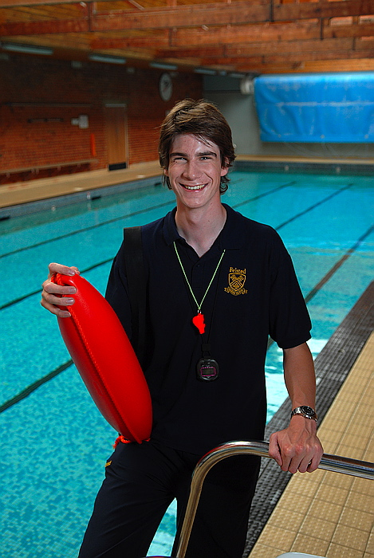
Volunteering
Aim
To inspire young people to make a difference within their communities or to an individual’s life and develop compassion by giving service to others.

Slide 13
Benefits
Learn about their community and feel a sense of belonging and purpose.
Learn to take responsibility for their communities and their own actions.
Build new relationships.
Further understand their own strengths and weaknesses.
Develop teamwork and leaderships skills.
Trust others and be trusted.
Enjoy new adventures.

Slide 14
What is required?
Volunteering is simple. It’s about choosing to give time to something useful, without getting paid.
Team volunteering can be beneficial to you and to the project you choose.
At least 3/4 of the activity needs to be practical volunteering, so only a 1/4 can be training.
Training courses, therefore, must either:
Change their content to include practical volunteering e.g. raising awareness of the project.
Count towards the Skills section – e.g. Life skills category.

Slide 15
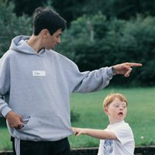
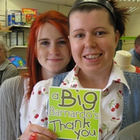
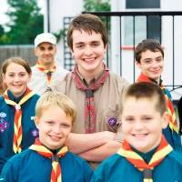
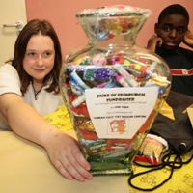
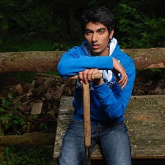
Volunteering categories
Helping people
Community action and raising awareness
Coaching, teaching and leadership
Working with the environment or animals
Helping a charity or community organisation
Notes:
Explain why we have chosen these activities – flexible enough that all volunteering activities should fit in. Old categories were very prescriptive. Make it clear that some activities will fit into more than one category, this doesn’t matter and will often depend on the aim of the young person.
This is outlined on pages 41 – 42 on the DofE Handbook.
Give example on page 42 of Handbook about how First Aid training could be 3 months as a Bronze Skill for one person or training for 3 months and 9 months practical volunteering with St John Ambulance as a Gold Volunteering activity for another.
You could use any example here:
A Bronze DofE group attends a police course once a week to learn about the criminal justice system. As part of the course, the group are asked to design a project to raise awareness about personal safety in their community. A Gold DofE programme participant supervises the group and the police officer is the Assessor. The group deliver a number of assemblies to their peers as well as at the local primary school on how to stay safe.

Slide 16
Physical
Aim
To inspire young people to achieve greater physical fitness and a healthy lifestyle through participation and improvement in physical activity.

Slide 17
Benefits
Enjoy keeping fit.
Improve fitness.
Discover new abilities.
Raise self-esteem.
Extend personal goals.
Set and respond to a challenge.
Experience a sense of achievement.

Slide 18
What is a physical activity?
In short, anything that requires a
sustained level of physical energy
and involves doing an activity.
You are free to do this section
independently or as part of a team.

Slide 19
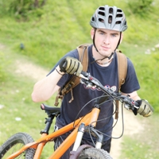
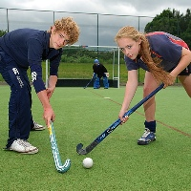
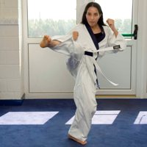
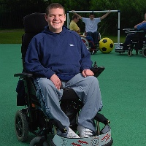
Physical categories
Team sports
Individual sports
Water sports
Racquet sports
Dance
Fitness
Extreme sports
Martial arts

Slide 20
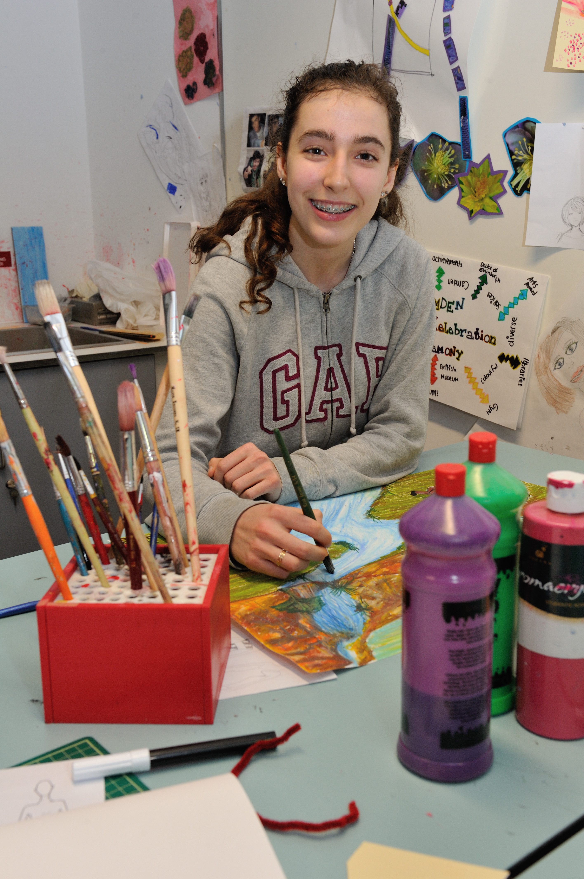
Skills
Aim
To inspire young people to develop practical and social skills and personal interests.

Slide 21
Benefits
Develop a new talent.
Improve self-esteem and confidence.
Develop practical and social skills.
Develop better organisational and time management skills.
Sharpen research skills.
Learn how to set and rise to a challenge.

Slide 22
Something old or something new
Ultimately you must be able to prove that
you have broadened your understanding
and increased your expertise in the chosen skill.
Activities can be undertaken on
either an individual or group basis.

Slide 23
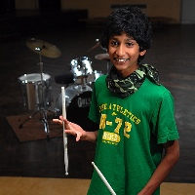
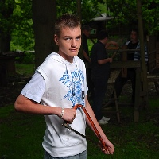
Skills categories
Creative arts
Performance arts
Science and technology
Care of animals
Music
Life skills
Learning and collecting
Media and communication
Natural world
Games and sports

Slide 24
Expedition
Aim
To inspire young people to develop initiative and a sense of adventure and discovery, by planning, training for and completing an adventurous journey as part of a team.

Slide 25
Benefits
Gain an appreciation of and respect for the outdoor environment.
Learn the value of sharing responsibility for success.
Learn the importance of attention to detail and organisational ability.
Develop and demonstrate enterprise and imagination.
Become more self-reliant.
Become more able to overcome challenges.
Recognise the needs and strengths of others.
Improve decision-making skills and the ability to accept consequences.
Gain skills to reflect on personal performance.
Learn to manage risk.
Learn through experience.

Slide 26
The expedition process
Preparation
Training
Practice expedition
Qualifying expedition, debrief and presentation
Assessment

Slide 27
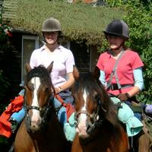
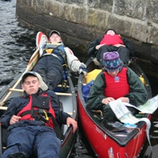
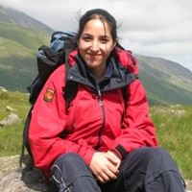
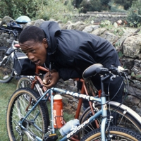
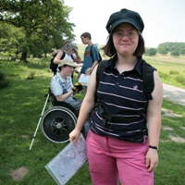
Expedition examples
This can be far flung or close to home:
Exploring team dynamics on foot in the Cairngorms.
Using cycle paths in Germany to compare to the UK.
Following a disused railway track by wheelchair.
Utilising canoe trails in Canada on a wilderness trip.
Exploring bridle paths in the Brecon Beacons.

Slide 28
Timescales for qualifying expeditions
Level | Duration | Minimum hours of planned activity each day
Bronze | 2 days and 1 night | At least 6 hours during the daytime (at least 3 of which must be spent journeying)
Silver | 3 days and 2 nights | At least 7 hours during the daytime (at least 3½ of which must be spent journeying)
Gold | 4 days and 3 nights | At least 8 hours during the daytime (at least 4 of which must be spent journeying)

Slide 29
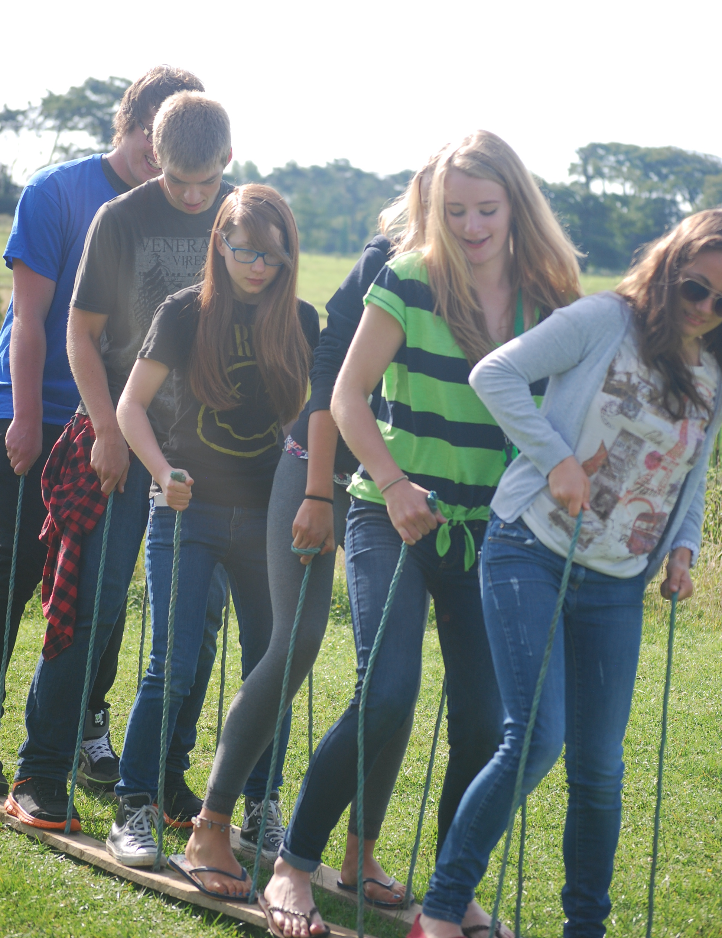
Residential (Gold only)
Aim
To inspire participants through a concentrated involvement with people they don’t know, who are usually from different backgrounds, and bring alternative views to the challenges they will face.

Slide 30
Benefits
Meet people.
Develop the confidence to thrive in an unfamiliar environment.
Build new relationships and show concern for others.
Work as part of a team towards shared goals.
Accept responsibility for themselves and others.
Develop communication skills and effective coping mechanisms.
Develop respect and understanding for others.
Show initiative.
Develop the skills and attitudes to live and work with others.

Slide 31
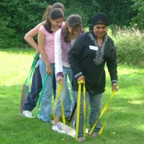
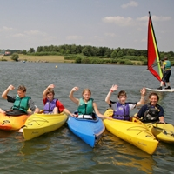
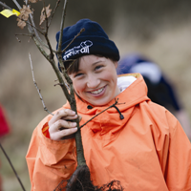
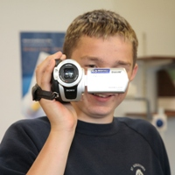
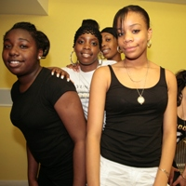
Residential examples
Developing an existing interest or something new:
Assisting at a kids’ summer camp.
Joining a conservation project.
Doing a photography course.
Improving language skills on an intensive course.

Slide 32
Next Step
If you are interested in completing your Duke of Edinburgh Award
Please collect a letter form Mr Mapperson
Please complete the Enrolment and pay the deposit by the Friday 18th December 2020

Slide 33
Any Questions?
Please E-mail dofe@sirgrahambalfour.staffs.sch.uk
Or
Visit the Duke of Edinburgh Web-site www.dofe.org

Slide 34
Have fun!

